Slide 1
CRIME DETECTION USING MACHINE LEARNING
Members:
Puneet Singla(16103059)
Rahul Katyal(16103060)
Rohan Dutt(16103065)
Sahil (16103070)
Group No. 12
Mentor :Dr Geeta Sikka

Slide 2
OBJECTIVE:
To develop a system that can be deployed at large scale for reducing the crime rate by automating various tasks:
Recognising faces of criminals at places such as airports, railway stations and other areas.
Number plate scanning which can be used to find suspicious vehicles and also can be used to automate generation of challans to vehicles not following traffic rules.
Find out threats or chances of crime by recognizing the scene like someone carrying weapon or some fight going on in the area

Slide 3
METHODOLOGY USED:
The following algorithms are used for the development of the project :
Optical Character Recognition
Face Recognition

Slide 4
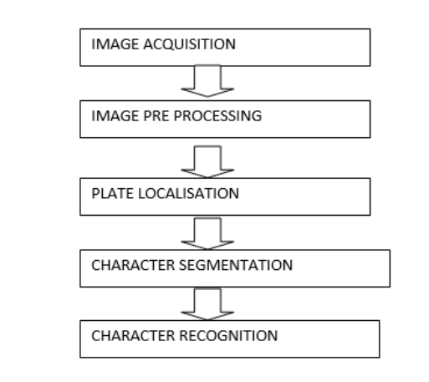
Optical Character Recognition

Slide 5
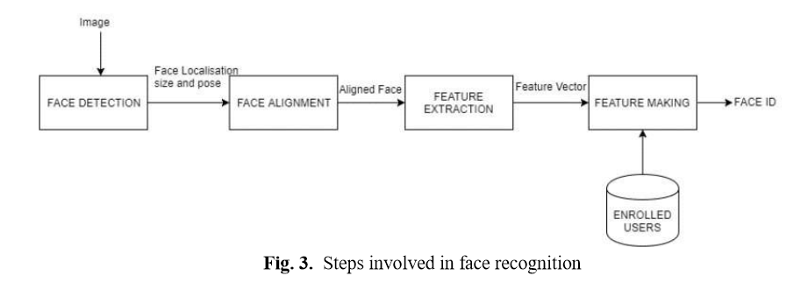
Face Recognition

Slide 6
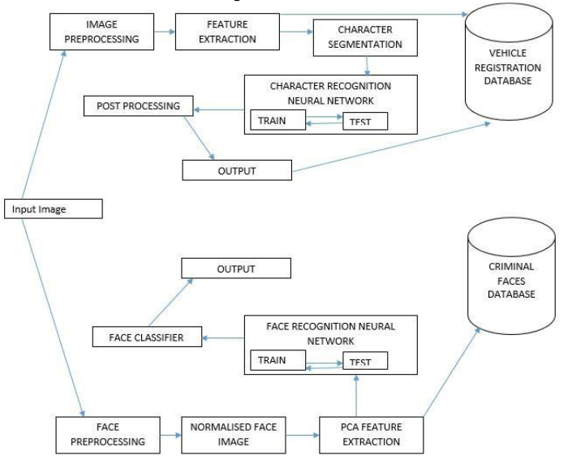
Workflow Diagram:

Slide 7
Threats
Time Constraints:
Large amount of data will be required for the model to train.
Problems may be faced while identifying sources for collection of data.
Further data augmentation needs to be done which also requires large amount of
time and labour.
Performance issues:
The real time monitoring requires large amount of machine power
Storage issues:
Large database is required for storing of data.

Slide 8
Technology Stack :
Front end:
HTML
CSS
Javascript
Back end:
Django (Python)
MySQL
Tools:
Anaconda

Slide 9
Implementation Phase I : Criminal Face Recognition

Slide 10
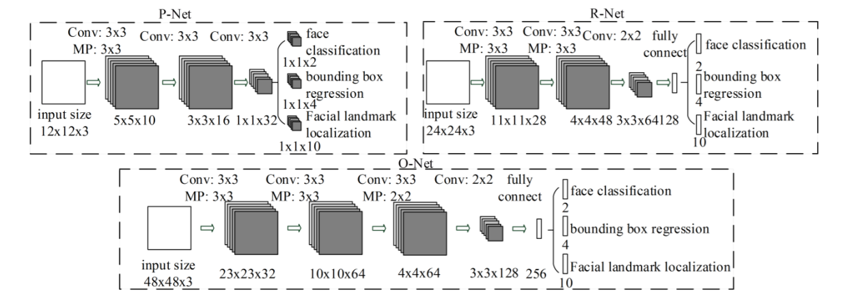
MTCNN Architecture:

Slide 11
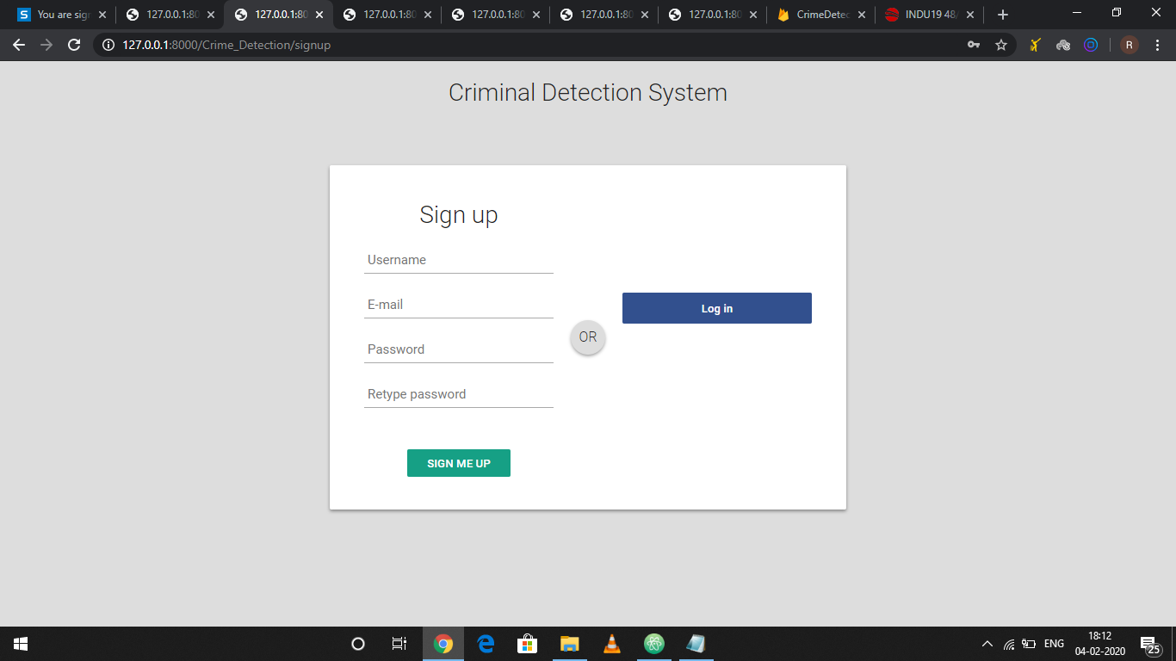
Prototype Screenshots:
1. Signup Window

Slide 12
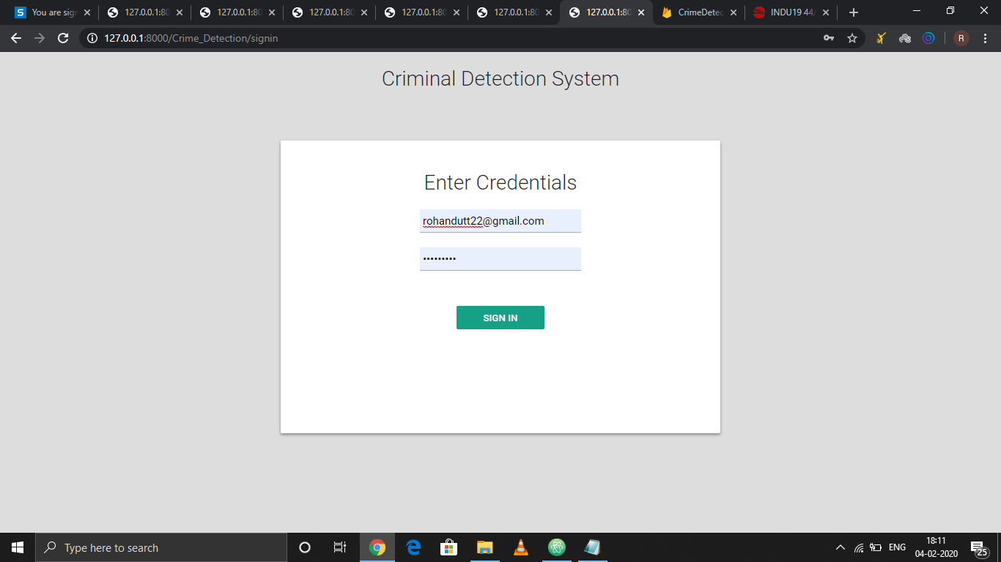
2. Sign-In Window:

Slide 13
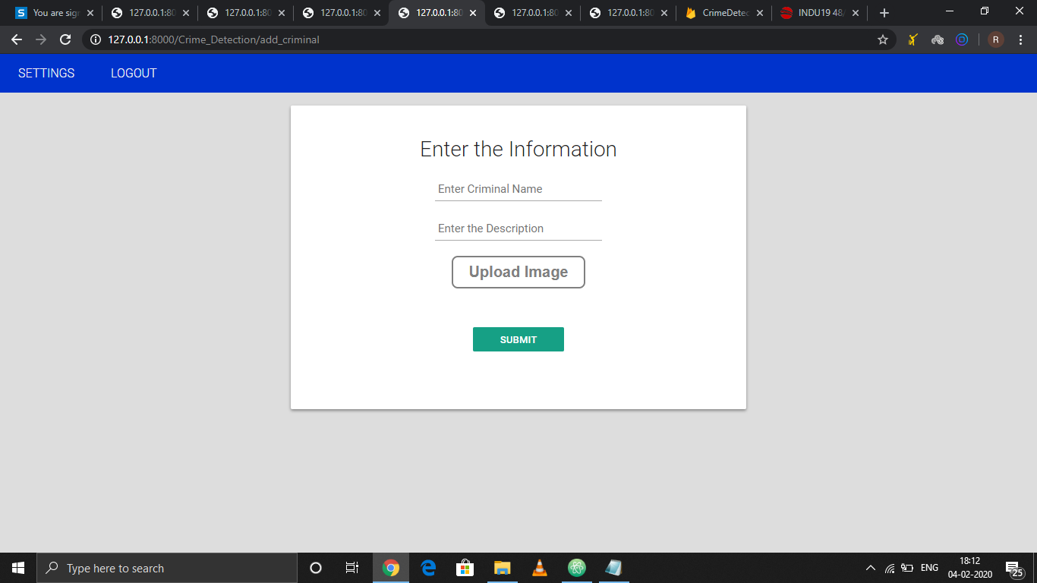
3. Add Criminal Window:

Slide 14
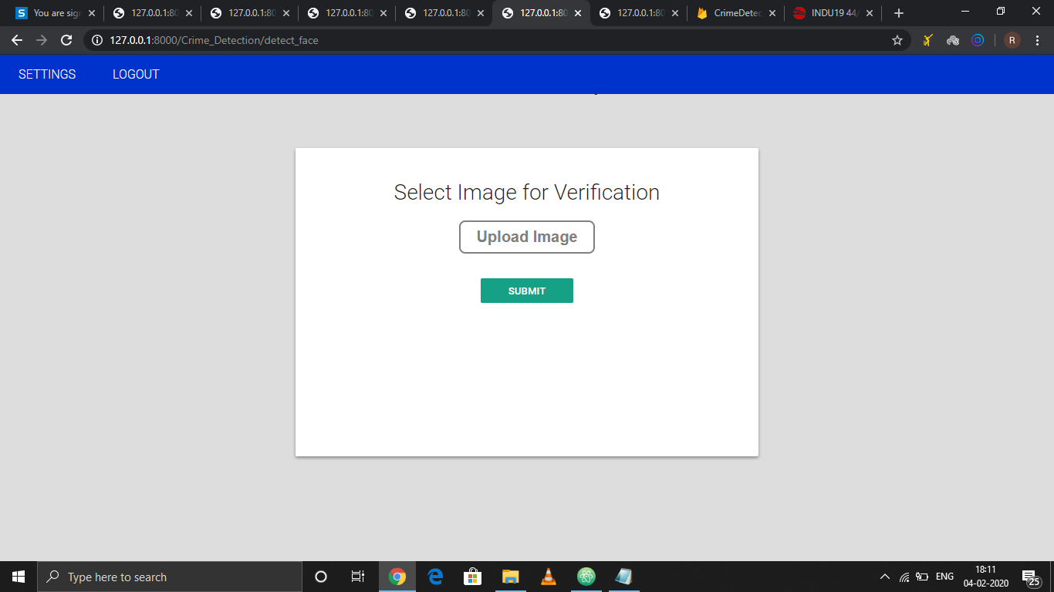
4. Detect Criminal Face Window:

Slide 15
THANK YOU

